Slide 1
Artevelde University College Ghent
June 17, 2013
Introducing

Slide 2
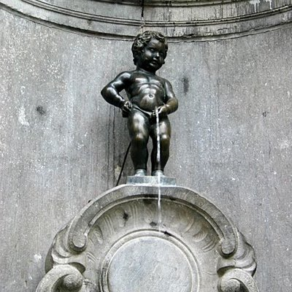
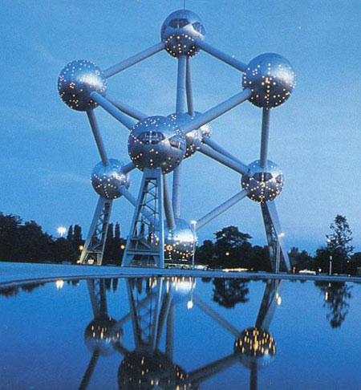
Belgium, in the heart of europe

Slide 3
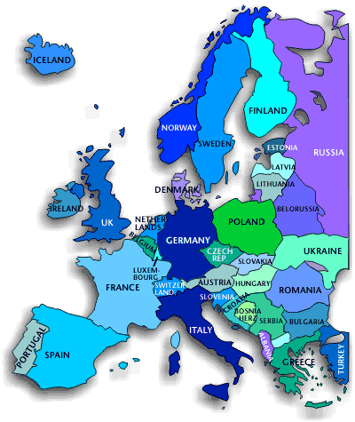
Belgium: general info
Arteveldehogeschool is in Belgium
Tekst niveau 1
Tekst niveau 2
Tekst niveau 3
Tekst niveau 4
Tekst niveau 5
Where? Western Europe
Surface: 30528 km²
Population: 10.584.534
Head of State: King Albert II
Host of the EU's headquarters
Herman Van Rompuy, a Belgian is the president of the European Council
Boundaries:
The Netherlands
Germany
France
UK (over North Sea)

Slide 5
Higher education in the flemish community (Flanders)

Slide 6
Higher Education System
General info
Shaped by the European developments in the framework of the Bologna Process
2 types of institutions: universities and university colleges => specific profiles but cooperate intensively
The Bachelor - Master structure:
Bachelor's degrees
professional bachelor's programmes: => only at University Colleges practice-oriented + periods of apprenticeships (at least 180 ECTS )
advanced bachelor's programmes: Further studies + deepening knowledge and/or competences acquired in professional bachelor's programme (at least 60 ECTS )

Slide 7
Higher Education System
Programmes
academic bachelor's programmes: Theoretic knowledge and further studies at master's level (at least 180 ECTS )
Master's degrees
consist of at least 60 ECTS credits concluded with a master's dissertation
academic orientation that brings advanced level of knowledge and competences
Advanced master's programmes
Further deepen knowledge and/or competences
PhD degrees
Doctoral programmes
Public presentation of a doctoral thesis based upon independent scientific research

Slide 8
Artevelde University College GHENT

Slide 9
Artevelde University College Ghent
Who? What, Where?
AHS is one of Flanders’ largest university colleges of professional education
AHS is situated in Ghent
65.000 students live in Ghent
centre of learning: unique combination of a high quality education with a variety of leisure life
Part of University Ghent Association since 2003

Slide 10
Artevelde University College Ghent
Degrees
Business Management
Office Management
Communication Management
Journalism
Graphical and Digital Media
Social Work
Bachelor of Business Management
Bachelor of Office Management
Bachelor of Communication Management
Bachelor of Journalism
Bachelor of Graphical and Digital Media
Bachelor of Social Work

Slide 11
Artevelde University College Ghent
Degrees
Speech and language therapy
Physiotherapy
Audiology
Nursing
Midwifery
Occupational therapy
Podiatry
Creative Therapy
Bachelor of Speech and language therapy
Bachelor and Master of Physiotherapy
Bachelor of Audiology
Bachelor of Nursing
Bachelor of Midwifery
Bachelor of Occupational therapy
Bachelor of Podiatry
Advanced Bachelor of Creative Therapy
flexible, credit-rated and competence-based

Slide 12
Artevelde University College Ghent
Degrees
Pre-school Education
Primary Education
Secondary Education
Early Childhood Education (NEW)
Special Education
Special Educational Needs and Remedial Teaching
School Development
Bachelor of Pre-school Education
Bachelor of Primary Education
Bachelor of Secondary Education
Bachelor of Early Childhood Education (NEW)
Advanced Bachelor of Special Education
Advanced Bachelor of Special Educational Needs and Remedial Teaching
Advanced Bachelor of Education: School Development (NEW)
graduates ready for the European labour market.

Slide 13
Artevelde University College Ghent
International Courses
BUSINESS MANAGEMENT:
Raising International Business Awareness (RIBA)
Artevelde Business School
COMMUNICATION MANAGEMENT :
Module in Communication Management (MOCOMA)

Slide 14
Artevelde Business School
The four obligatory courses are:
EU: Institutions, Politics and Trade (4 ECTS)
European Business (4 ECTS)
Socio-Economic Case Studies (4 ECTS)
E-Business in the EU (4 ECTS)

Slide 15
Artevelde Business School: electives
Entrepreneurship (4 ECTS)
Strategic Marketing & Communication (8 ECTS)
International Marketing (3 ECTS)
E-Marketing (6 ECTS)
Innovation & Growth (10 ECTS)
ERP and Internal Control (3 ECTS)
ERP & Software for Logistics (4 ECTS)
International Business Game
(4 ECTS)
Communication & Sponsoring
(3 ECTS)
Cultural Events Management
(3 ECTS)
Sports Event Management (3 ECTS)
Leisure Events Management
(3 ECTS)
MICE (Meetings, Incentives, Conferences and Exhibitions Management) (3 ECTS)
Business English and/or Business French (5 ECTS)
Dutch for Beginners (5 ECTS)

Slide 16
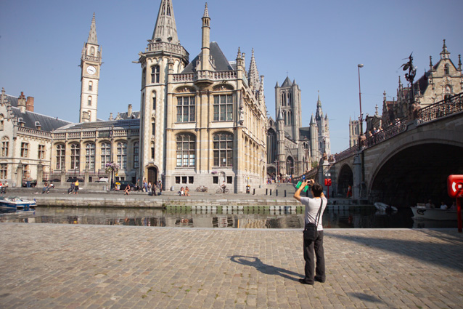
Artevelde University College Ghent
Ghent: some snapshots…

Slide 17
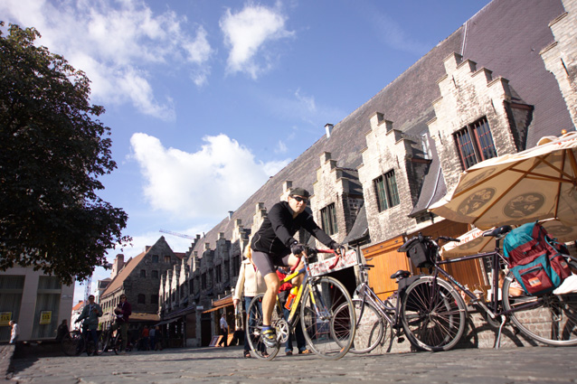
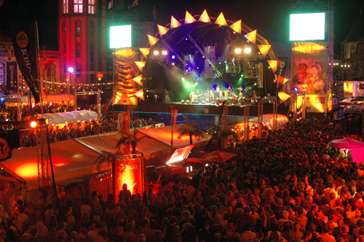
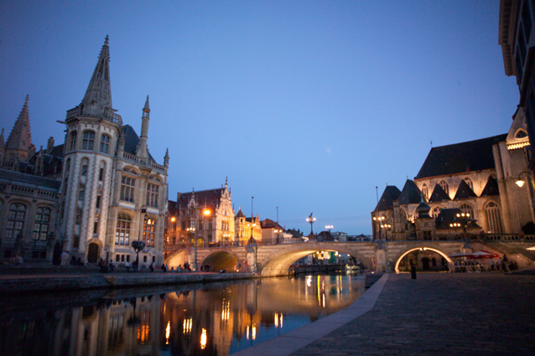
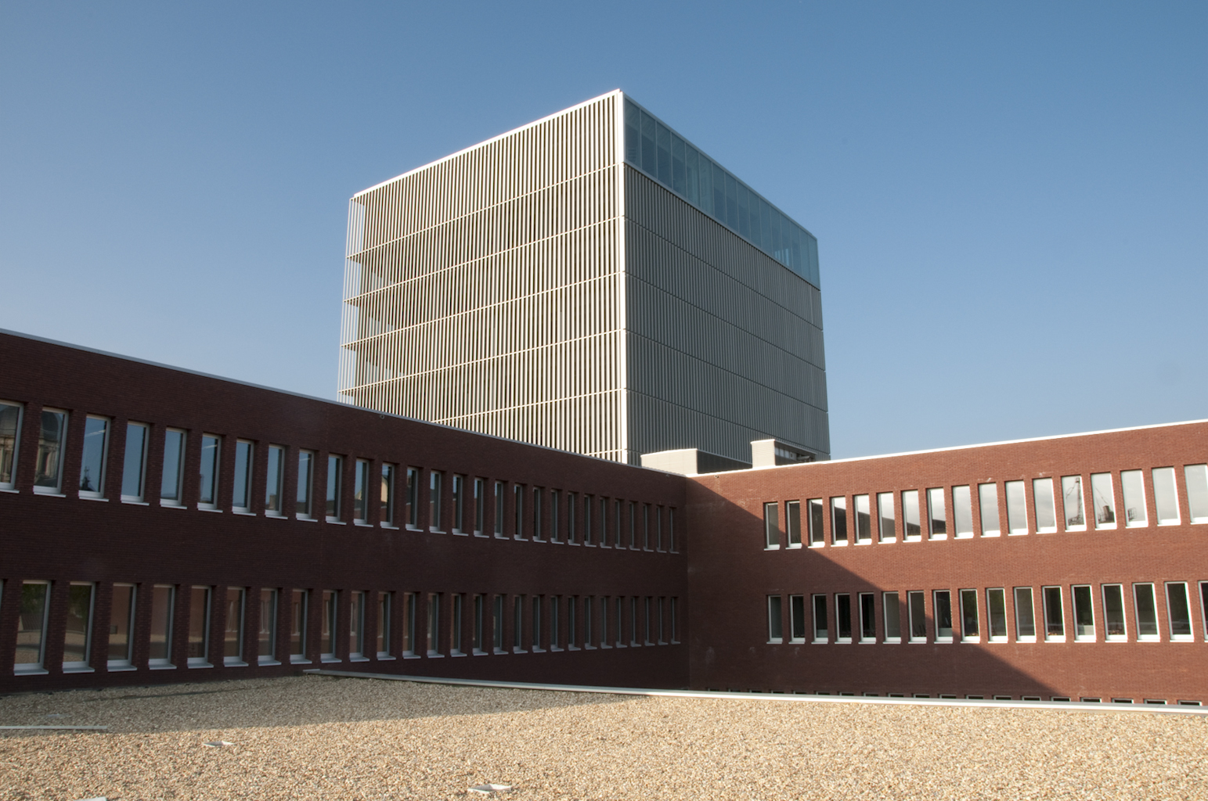

Slide 18
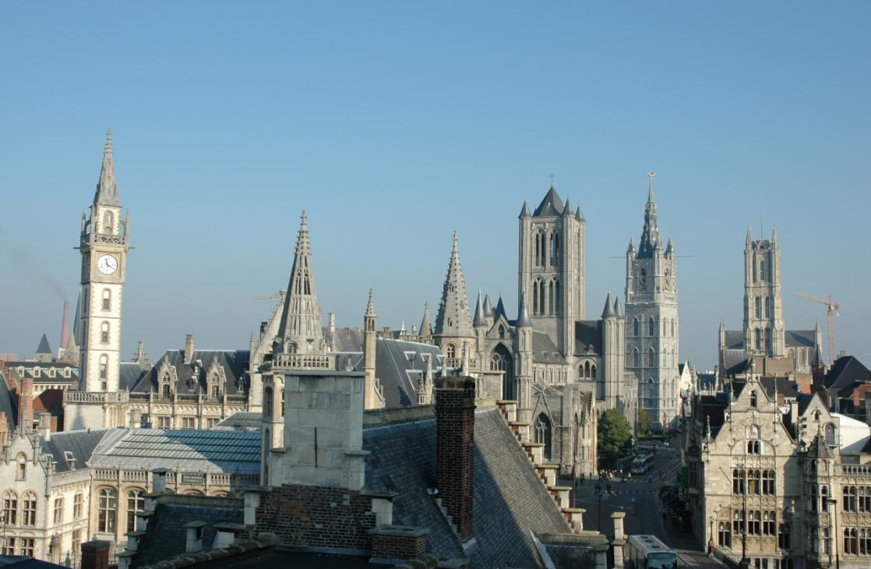
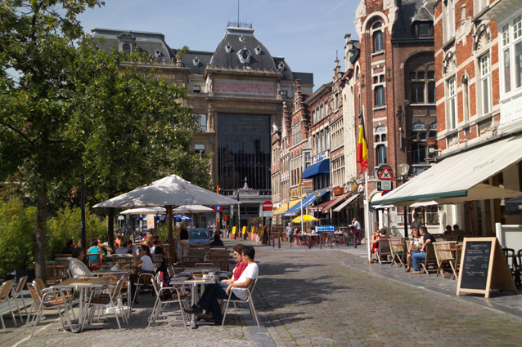
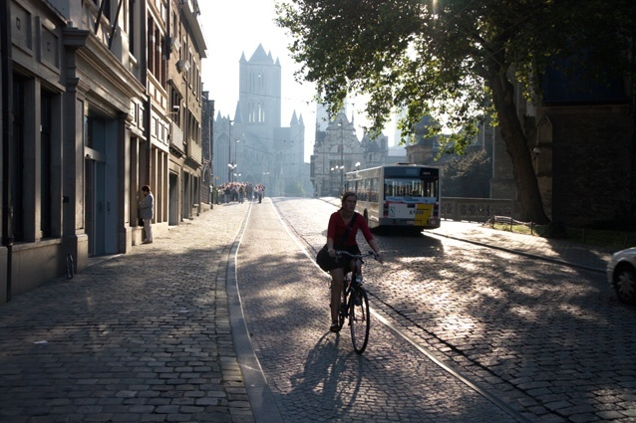
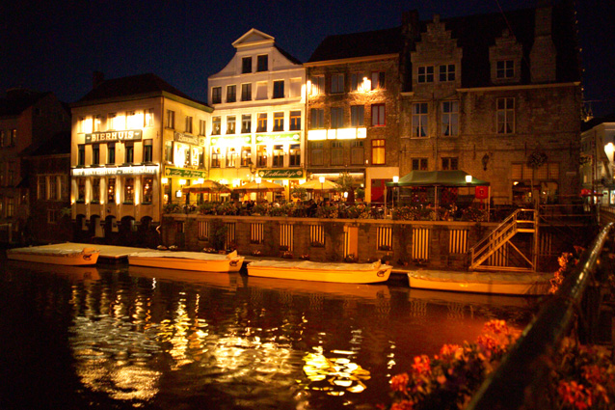

Slide 19
Artevelde University College Ghent
Examples of international activities
Around 143 international partners
Student mobility
I@H
Staff mobility
Strategic alliances:
regional: Ghent University Association
international: networks/consortia e.g.
EASSW (Social Work)
Comenius Association (Teacher Training)
COHEHRE (Health Care)
BUSINET (Business Studies)
International projects include:
ERASMUS Intensive Programmes
Intensive Programmes (no ext. funding)
ERASMUS Curriculum Development Projects
Comenius, Grundtvig
Leonardo da Vinci

Slide 20
Artevelde University College Ghent
Useful links
Ghent University Association
www.augent.be
Gent, the city
www.visitgent.be
www.use-it.be
Flanders, the region
www.visitflanders.be
Higher Education in Flanders
www.ond.vlaanderen.be/english
www.studyinflanders.be
www.highereducation.be
Belgium, the country
www.belgium.fgov.be
Europe and the ERASMUS-programme
www.europa.eu/
http://ec.europa.eu/index_en.htm
Erasmus Student Network
Transport to and in Belgium
www.brussels-airlines.be (air)
www.b-rail.be (rail)
www.delijn.be (bus)

